Slide 1
Traffic congestion data exploration

Slide 2
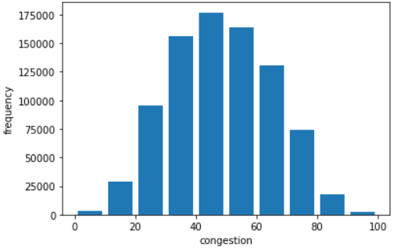
Congestion frequency graph

Slide 3
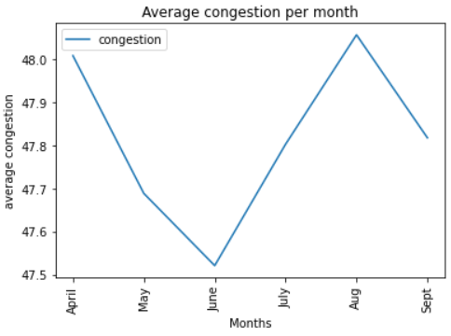
Average congestion per month

Slide 4
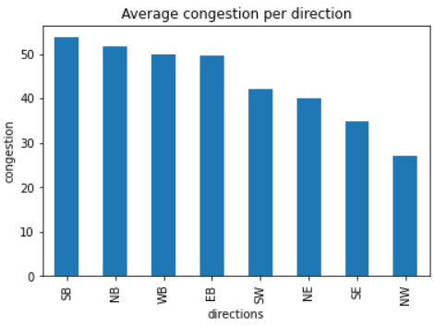
Average congestion per direction

Slide 5
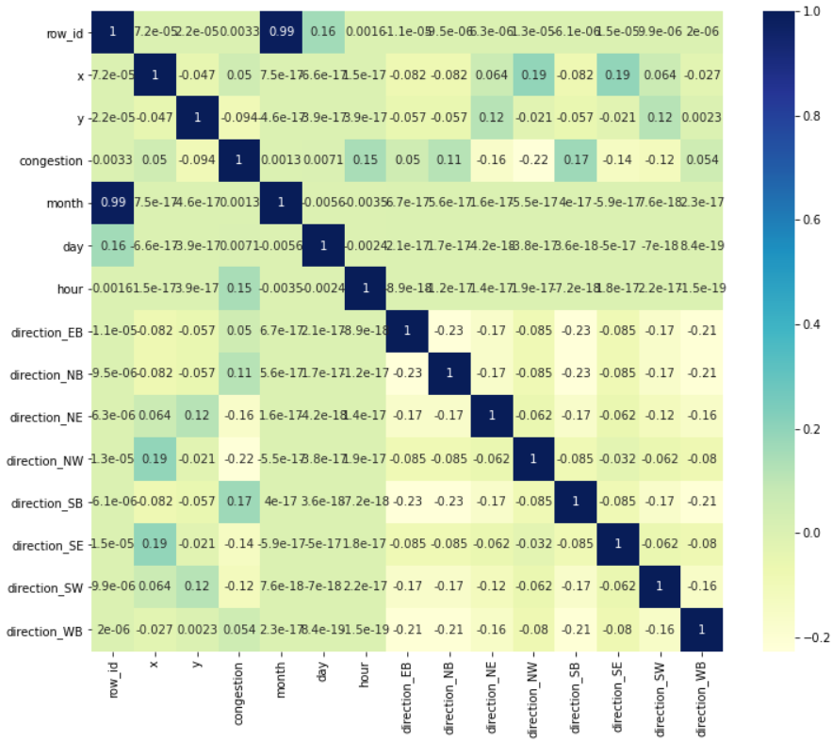
Dataset correlations

